Slide 1

Project AccorD
Team AccorD

Slide 2
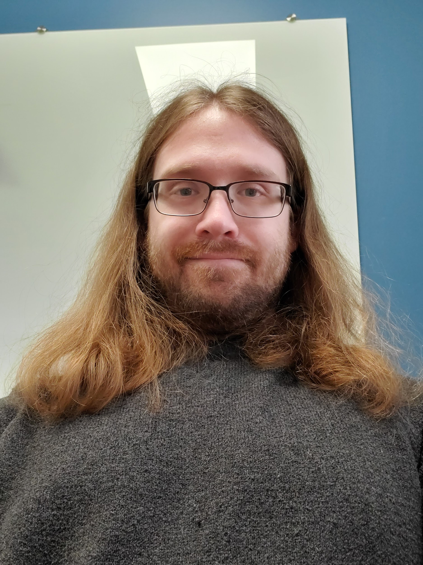
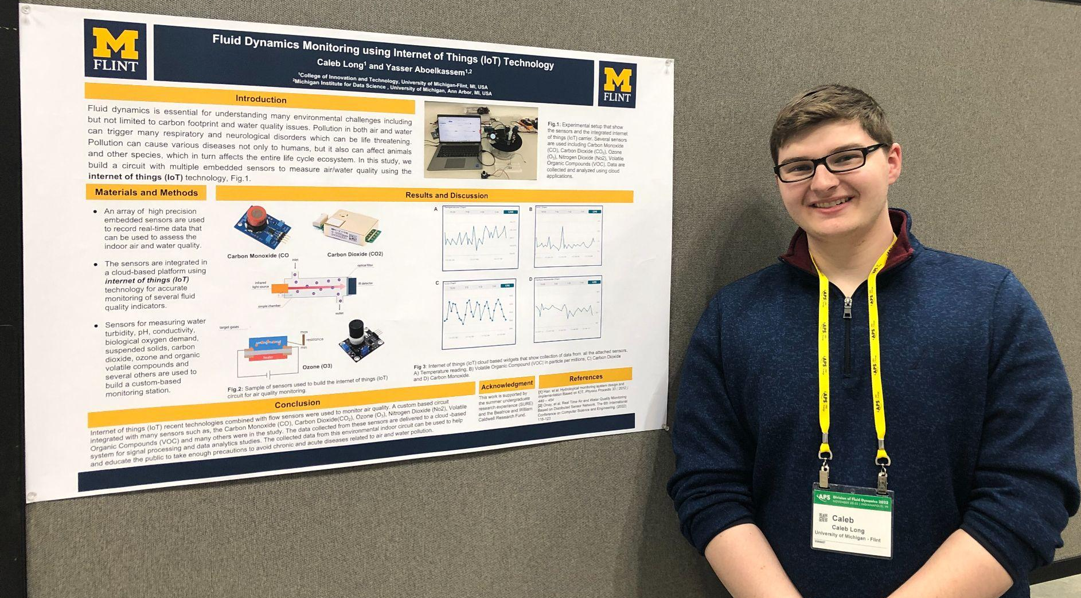
Team AccorD is…
Caleb Long
Joey Henry
and

Slide 3

Problem
The problem that we had set out to solve with our final project was the creation of a simple web-based chat application that is hosted entirely online from the cloud that would allow for people to connect instantly and chat with others online

Slide 4


Solution
We went about this by first creating a webpage for our application using HTML
Then we fleshed out its design with some CSS and Bootstrap
Our server was created using JQuery and we utilized the AWS to host it all and run on the cloud independently

Slide 5
Demo
Don't play the video. You need to run your project and explain how it works. (Remove this text for the final presentation)

Slide 6
Lessons Learned
Working on this project taught us a lot of things such as:
How to connect a database from Pgadmin to the AWS’s RDS as well as hosting things like images and such for a webpage from the S3 and running the server from a virtual machine on the EC2
Acquired a deeper understanding of node.js and how to set things up with it as well as its commands and other various terminal commands

Slide 7

Issues/Bugs Known
The EC2 had completely removed our instance and we had to restart it from scratch
Problems with aspects like the node modules folder not being where it was supposed to
Had to install some extra dependencies for node like express and pg

Slide 8

Future Versions
For potential future versions of this project we could see things like:
A more fleshed out original design for the webpage as well as additional pages
Ability for users to create their own private chat rooms with custom names and other potential personalizations

Slide 9
Thank you!
Any questions?

